Slide 1
Object-Oriented Design Patterns
Card Games
Group 1
Ajmal
Gengda
Yanqi
1

Slide 2
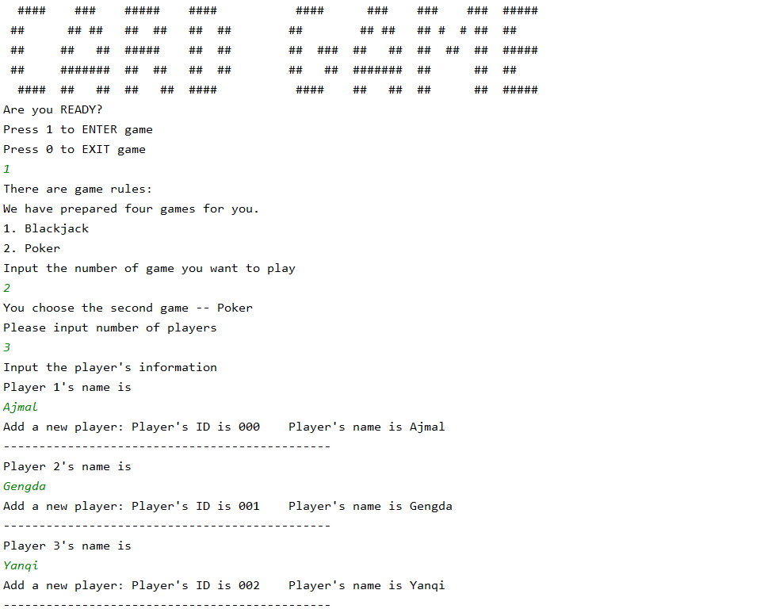
Card Games
Demonstration
2

Slide 3
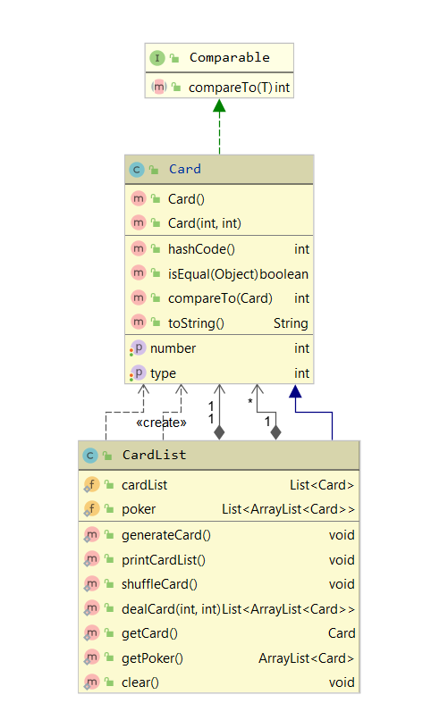
Factory Method
Defines an interface for creating objects, but let subclasses to decide which class to instantiate.
Refers to the newly created object through a common interface.
In our project, we define a factory interface Card() that creates product objects, deferring the actual creation of product objects generateCard() into specific sub-factory classes.
3

Slide 4
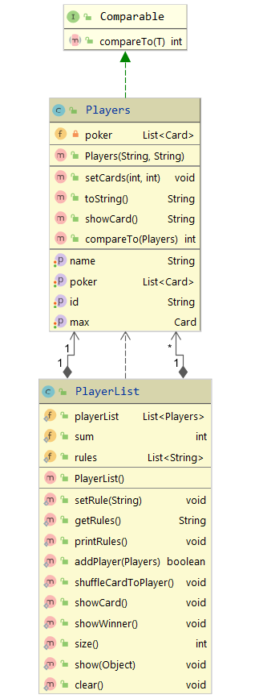
Template Method
Define the skeleton of an algorithm in an operation, deferring some steps to subclasses.
Template Method lets subclasses redefine certain steps of an algorithm without letting them to change the algorithm's structure.
The actions that players choose for different games are not exactly the same, but there are many steps to repeat.
For example, in each game, players should showCard() and showWinner(int)
4

Slide 5
Template Method
Each player will be assigned a different number of hands according to different games, and there are many similar operations. Although they are different, there are many repeated steps.
For example, each game should generateCard(), and then shuffleCard() and dealCard(), at the end of game, it will printCardList() of each player.
5

Slide 6
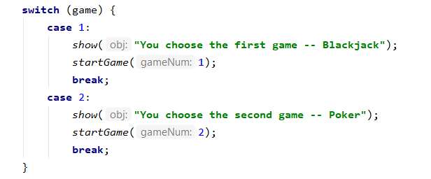
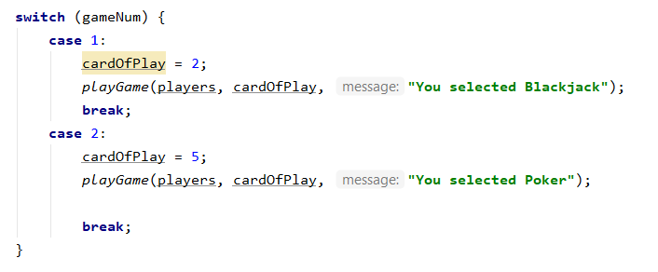
Strategy
Define a family of algorithms, encapsulate each one, and make them interchangeable. Strategy lets the algorithm vary independently from clients that use it.
In our card game program, the client needs to react to the player's input to enter different games.
We accept the numbers game entered by the user. Then we judge the number by switch and start the corresponding game program.
6

Slide 7
END
Card Games
Group 1
Ajmal
Gengda
Yanqi
7

